Slide 1
ICS-4UI Final Project
By: Riley Anderson

Slide 2
Progress of Specifications
This program was made to demonstrate concepts that I have learned in my physics and advanced functions classes

Slide 3
Original Release Schedule
Release Name | New incremental features of this release
1.0 | Advanced functions Program, Physics programs created
1.1 | Create methods for all different units
1.11 | Create program for Velocity, make frame and the layout
1.2 | Be able to ask any question for unit 1 in either program
1.3 | Create Program for Graphing Calculator, make frame and layout
2.0 | Have all questions for units 2 in both programs
2.1 | For Velocity program, display whether the object has positive or negative velocity and current velocity
2.11 | For Calculator program, display the graph with some points on the axis
3.0 | Finish Velocity program, insert setting for acceleration and display it
3.1 | Graphing, insert buttons to enter the equation to be graphed
3.1 | Pass answers between methods to answer different questions
3.2 | Have programs explain how they got to calculate each answer
4.0 | Update equation program to answer questions from all units up to date
4.1 | Create program for gravity, insert frame and border layout
4.2 | Finish graphing calculator program, be able to enter any equation and graph the equation
5.0 | Insert object into gravity program and make it fall from top to bottom of the screen.
5.1 | Make sure to keep functionality of program up to speed so it will be easy to use
5.2 | Insert menu to change the level gravity to affect the speed of the drop
6.0 | Make sure all questions are included in every unit and every scenario is included
7.0 | Test final functionality of program and hand it in

Slide 4
New Release Schedule
Release Name | New incremental features of this release
1.0 | One Project made for both physics and functions created
1.1 | Basic structure inputted for displaying each courses information on the screen
1.5 | Question classes created and more functionality in structure made
2.0 | Changed structure to make different panels visible at a time based on what the user chose
3.0 | Changed structure completely to card layout to have different cards for physics and functions
3.1 | Tabbed panes added in both units cards to switch between demonstrations
3.2 | Drop down boxes added in the velocity section to choose different settings
4.0 | Backgrounds added for every choice in velocity
4.1 | Moving image across the screen with different speeds for every sprite chosen
4.2 | Acceleration factor just starting to be put into the demo
5.0 | Acceleration incorporated to make sprites speed up and slow down
5.1 | Gravity section added to drop sprites at different speeds based on which was chosen

Slide 5
Show the Program

Slide 6
Bugs
Clicking start or stop in the gravity section before choosing a sprite
Moving the sprite in velocity before it comes to a full stop
In velocity sometimes the sprite will come to a stop right before it resets sides

Slide 7
Classes
Structures
Main
FraMain
PanUnitChooser
PanFirstCard
PanPhysics
PanFunctions
Physics
PanTabbedP
PanDispP
PanSidewalk
PanSkatePark
PanRoad
PanSpace
PanJupiter
PanMars
PanEarth
PanButtonTimer
Functions
PanTabbedF
Sprites
SprPerson
SprSkateBoard
SprCar
SprRocket
SprAnvil
SprMartian
SprRock

Slide 8
Unique Challenges
Focus Issues
Key listener and button listener not working together
Whenever you clicked a button the key listener would stop working
Had to make the panel that was making the movement request the focus back every time a button was clicked

Slide 9
New Programing Techniques
Tabbed Panes
Easy to switch between options in a panel
Makes it easier to navigate
Drop Down Boxes
Much easier to use than a bunch of buttons
Makes it much more organized

Slide 10
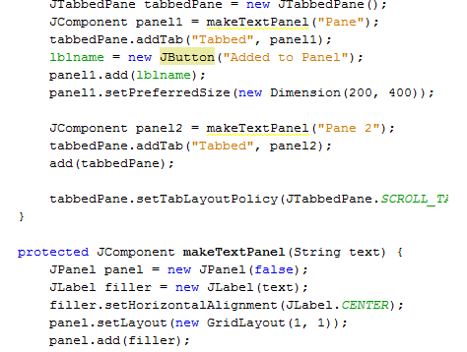

Tabbed Panes
Drop Down Boxes

Slide 11
Biggest Frustrations
Structure
Wasn’t smooth switching between units
Very ugly code
Not efficient
Movement
Wasn’t working along with button listeners
Movement was clunky
Acceleration wasn’t smooth
Slowing down didn’t work

Slide 12
Notes to Future Programmers
Get lots of different settings and variables incorporated
Add something into the Functions portion
Get better images for sprites

Slide 13
Questions?

Slide 14
The End

